Slide 1
Tutorial 6: oct 19
Project Stuff

Slide 2
Project Template
Define Inputs & initial conditions
Define State Variables
Define user interaction
How will the user be able to influence the program?
Define coordinate system
Local (with respect to the object)
Global (with respect to the program)
Create a class for every object
Will contain parameters
Coordinates
mesh
Create a function that updates State Variables
Create Function that Reads inputs
You want this function to be called often since it is possible your program is too fast and doesn’t register inputs
Create Simulation loop
Update state variables
Updates coordinates
Redraws objects on screen

Slide 3
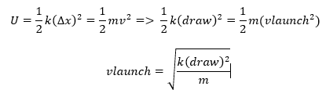

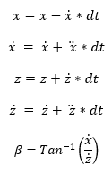
Project Example
Define Inputs
Define State Variables
Define user interaction:
Move archer
Change launch angle
Set Power
Change Gravity
Classes
World (background)
Archer
Arrow
Target
Boxes

Slide 4
Calculate Xd
double Arrow::calculate_Xd(){
//dt is constant double in main program
//Unpacking state variables
double x = X[1]; double vx = X[2];
double z = X[3]; double vz = X[4];
//Write state Equations
double xd = vx;
double xdd = (U[3])*G*M_planet*m_arrow / pow(R_planet, 2); //using actual gravity equation instead of 9.81
double zd = vz;
double zdd = (U[4])*G*M_planet*m_arrow / pow(R_planet, 2);
//pack the state derivation vector
Xd[1] = xd; Xd[2] = xdd; Xd[3] = zd; Xd[4] = zdd;
return 0;}
Although unpacking and packing variables is not necessary when actually programming, Its better to follow his example so it makes his life easier, making your grade better ☺

Slide 5
Eulers
void Arrow::eulers() {
//calculate_Xd(X[], dt, Xd[], U[]);
X[1] = X[1] + Xd[1] * dt;
if (X[2] < -200) X[2] = -200;
else if (X[2] > 200) X[2] = 200;
Else {X[2] = X[2] + Xd[2] * dt;}
X[3] = X[3] + Xd[3] * dt;
if (X[4] > 200) X[4] = 200;
else if (X[4] < -200) X[4] = -200;
Else {X[4] = X[4] + Xd[4] * dt;}
if (X[2] > 0) Theta = (PI)-atan(X[4] / X[2]);
Else Theta = -atan(X[4] / X[2]); // check if pitch is dependent on gravity}

Slide 6
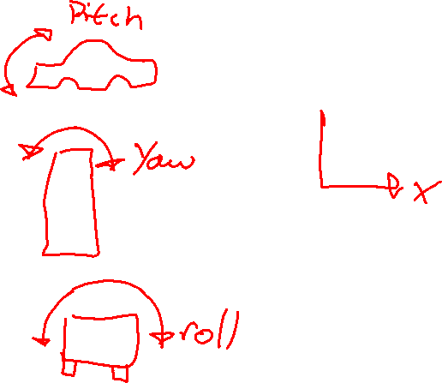
Rendering your project
archer = new mesh("Archer.x");
archer->draw(X, Y, Z, Yaw, Pitch, Roll);

Slide 7
Project Example

Slide 8
Shared Memory
Concept introduced later but easy to implement and easily boost your mark.
Basically two programs running at once and communicating with one another.
One program can run your simulation, the other can output data to csv or txt.

Slide 9
